Slide 1
Python Programming
Myanmar IT Bootcamp
Zero to Pro CS Bootcamp Level-4

Slide 2
Chapter (1)
Python Introduction

Slide 3
Python is a general-purpose interpreted, interactive, object-oriented, and high-level programming language. It was created by Guido van Rossum during 1985- 1990.
Why to Learn Python?
Python is a high-level, interpreted, interactive and object-oriented scripting language. Python is designed to be highly readable. It uses English keywords frequently where as other languages use punctuation, and it has fewer syntactical constructions than other languages.

Slide 4
Python is Interpreted − Python is processed at runtime by the interpreter. You do not need to compile your program before executing it. This is similar to PERL and PHP.
Python is Interactive − You can actually sit at a Python prompt and interact with the interpreter directly to write your programs.
Python is Object-Oriented − Python supports Object-Oriented style or technique of programming that encapsulates code within objects.
Python is a Beginner's Language − Python is a great language for the beginner-level programmers and supports the development of a wide range of applications from simple text processing to WWW browsers to games.

Slide 5
History of Python
Python was developed by Guido van Rossum in the late eighties and early nineties at the National Research Institute for Mathematics and Computer Science in the Netherlands.
Python is derived from many other languages, including ABC, Modula-3, C, C++, Algol-68, SmallTalk, and Unix shell and other scripting languages.
Python is copyrighted. Like Perl, Python source code is now available under the GNU General Public License (GPL).
Python is now maintained by a core development team at the institute, although Guido van Rossum still holds a vital role in directing its progress.

Slide 6
Python Identifiers
A Python identifier is a name used to identify a variable, function, class, module or other object. An identifier starts with a letter A to Z or a to z or an underscore (_) followed by zero or more letters, underscores and digits (0 to 9).
Python does not allow punctuation characters such as @, $, and % within identifiers. Python is a case sensitive programming language. Thus, Manpower and manpower are two different identifiers in Python.

Slide 7
Class names start with an uppercase letter. All other identifiers start with a lowercase letter.
Starting an identifier with a single leading underscore indicates that the identifier is private.
Starting an identifier with two leading underscores indicates a strongly private identifier.
If the identifier also ends with two trailing underscores, the identifier is a language-defined special name.

Slide 8
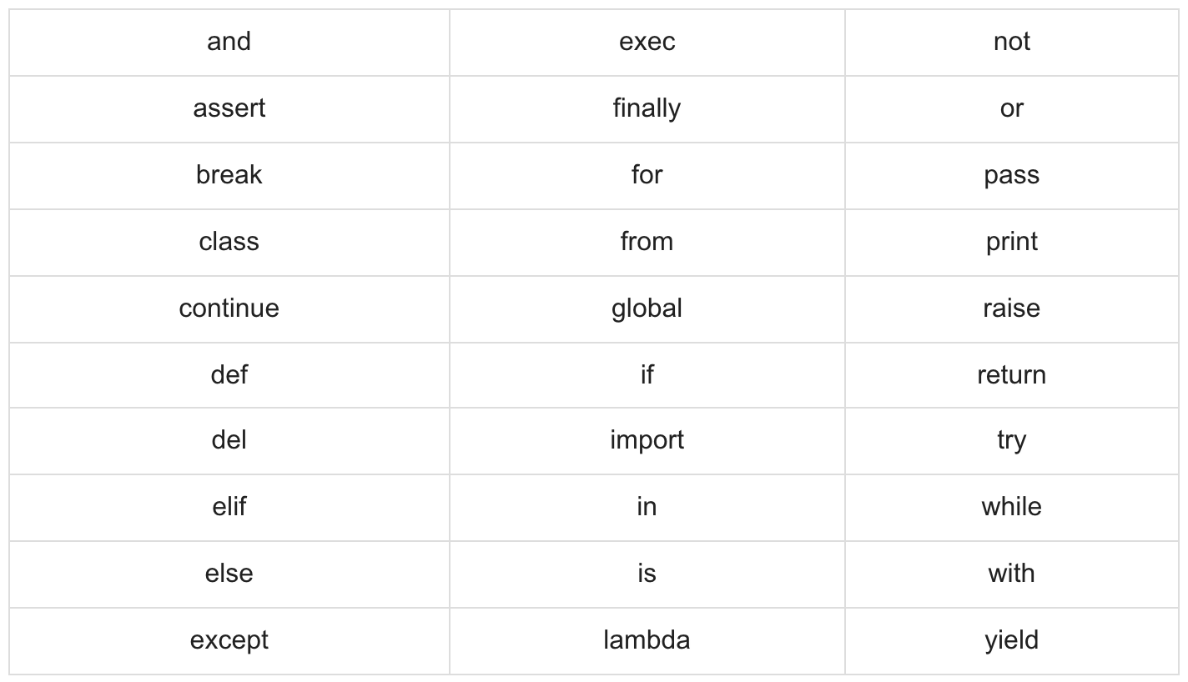
Reserved Words
These are reserved words and you cannot use them as constant or variable or any other identifier names. All the Python keywords contain lowercase letters only.

Slide 9
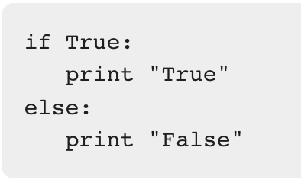
Lines and Indentation
Python provides no braces to indicate blocks of code for class and function definitions or flow control. Blocks of code are denoted by line indentation, which is rigidly enforced.
The number of spaces in the indentation is variable, but all statements within the block must be indented the same amount. For example −

Slide 10
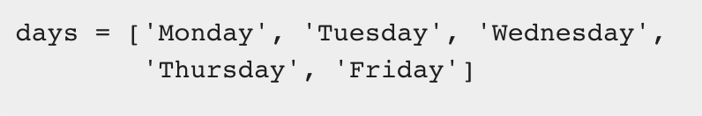
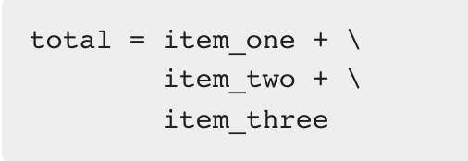
Multi-Line Statements
Statements in Python typically end with a new line. Python does, however, allow the use of the line continuation character (\) to denote that the line should continue.
Statements contained within the [], {}, or () brackets do not need to use the line continuation character.

Slide 11
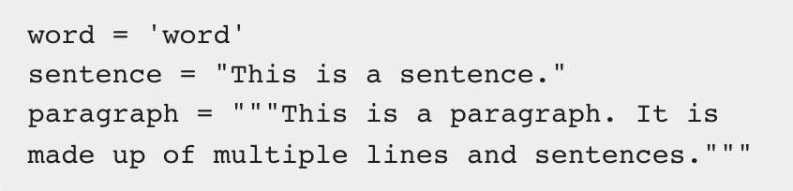
Quotation in Python
Python accepts single ('), double (") and triple (''' or """) quotes to denote string literals, as long as the same type of quote starts and ends the string.

Slide 12
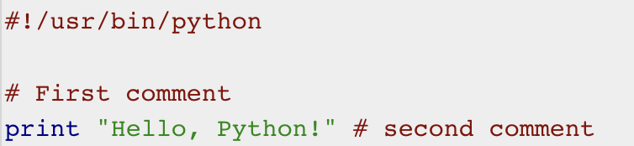
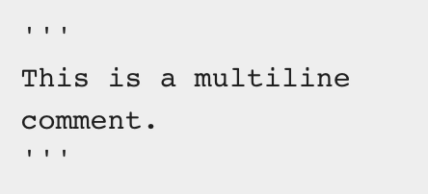
Comments in Python
A hash sign (#) that is not inside a string literal begins a comment. All characters after the # and up to the end of the physical line are part of the comment and the Python interpreter ignores them.
Following triple-quoted string is also ignored by Python interpreter and can be used as a multiline comments:
Live Demo

Slide 13
Chapter (2)
Python Variables Data Types

Slide 14
Python - Variable Types
Variables are nothing but reserved memory locations to store values. This means that when you create a variable you reserve some space in memory.
Based on the data type of a variable, the interpreter allocates memory and decides what can be stored in the reserved memory. Therefore, by assigning different data types to variables, you can store integers, decimals or characters in these variables.

Slide 15
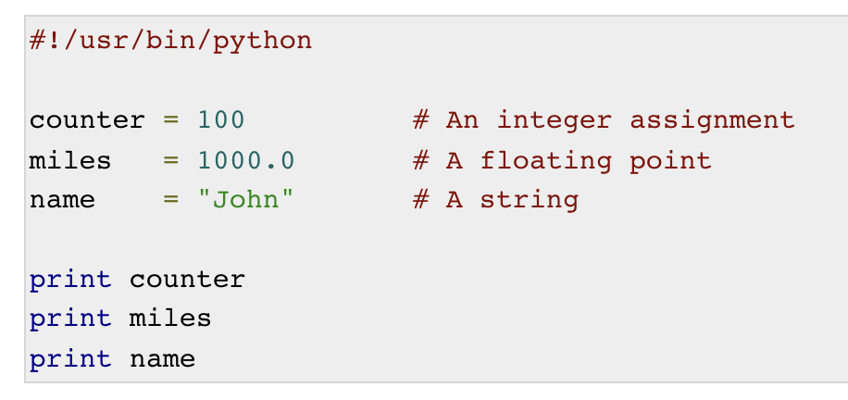
Assigning Values to Variables
Python variables do not need explicit declaration to reserve memory space. The declaration happens automatically when you assign a value to a variable. The equal sign (=) is used to assign values to variables.
The operand to the left of the = operator is the name of the variable and the operand to the right of the = operator is the value stored in the variable. For example −

Slide 16
Multiple Assignment
Python allows you to assign a single value to several variables simultaneously. For example −
a = b = c = 1
Here, an integer object is created with the value 1, and all three variables are assigned to the same memory location. You can also assign multiple objects to multiple variables. For example −
a,b,c = 1,2,"john"

Slide 17
Standard Data Types
The data stored in memory can be of many types. For example, a person's age is stored as a numeric value and his or her address is stored as alphanumeric characters. Python has various standard data types that are used to define the operations possible on them and the storage method for each of them.
Python has five standard data types −
Numbers
String
List
Tuple
Dictionary

Slide 18
Python Numbers
Number data types store numeric values. Number objects are created when you assign a value to them. For example −
var1 = 1 ; var2 = 10
You can delete a single object or multiple objects by using the del statement. For example −
del var ; del var_a, var_b
Python supports four different numerical types −
int (signed integers)
long (long integers, they can also be represented in octal and hexadecimal)
float (floating point real values)
complex (complex numbers)

Slide 19
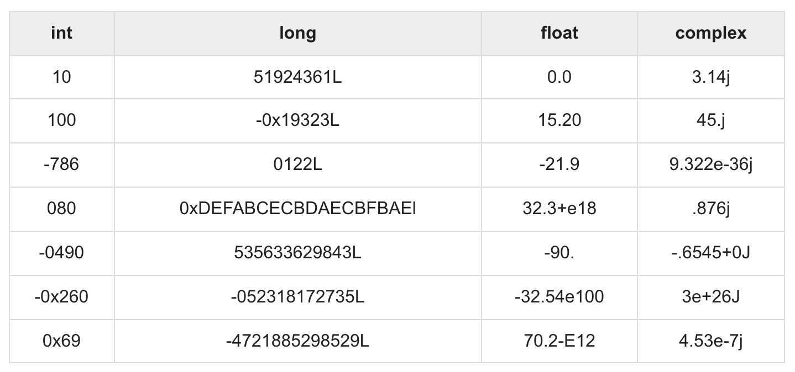

Slide 20
Python Strings
Strings in Python are identified as a contiguous set of characters represented in the quotation marks. Python allows for either pairs of single or double quotes. Subsets of strings can be taken using the slice operator ([ ] and [:] ) with indexes starting at 0 in the beginning of the string and working their way from -1 at the end.
The plus (+) sign is the string concatenation operator and the asterisk (*) is the repetition operator.

Slide 21
str = 'Hello World!'
print(str) # Prints complete string
print(str[0]) # Prints first character of the string
print(str[2:5]) # Prints characters starting from 3rd to 5th
print(str[2:]) # Prints string starting from 3rd character
print(str * 2) # Prints string two times
print(str + "TEST") # Prints concatenated string

Slide 22
Python Lists
Lists are the most versatile of Python's compound data types. A list contains items separated by commas and enclosed within square brackets ([]). To some extent, lists are similar to arrays in C. One difference between them is that all the items belonging to a list can be of different data type.
The values stored in a list can be accessed using the slice operator ([ ] and [:]) with indexes starting at 0 in the beginning of the list and working their way to end -1. The plus (+) sign is the list concatenation operator, and the asterisk (*) is the repetition operator.

Slide 23
list = [ 'abcd', 786 , 2.23, 'john', 70.2 ]
tinylist = [123, 'john']
print(list) # Prints complete list
print(list[0]) # Prints first element of the list
print(list[1:3]) # Prints elements starting from 2nd till 3rd
print(list[2:]) # Prints elements starting from 3rd element
print(tinylist * 2) # Prints list two times
print(list + tinylist) # Prints concatenated lists

Slide 24
Python Tuples
A tuple is another sequence data type that is similar to the list. A tuple consists of a number of values separated by commas. Unlike lists, however, tuples are enclosed within parentheses.
The main differences between lists and tuples are: Lists are enclosed in brackets ( [ ] ) and their elements and size can be changed, while tuples are enclosed in parentheses ( ( ) ) and cannot be updated. Tuples can be thought of as read-only lists.

Slide 25
tuple = ( 'abcd', 786 , 2.23, 'john', 70.2 )
tinytuple = (123, 'john')
print(tuple) # Prints the complete tuple
print(tuple[0]) # Prints first element of the tuple
print(tuple[1:3]) # Prints elements of the tuple starting from 2nd till 3rd
print(tuple[2:] ) # Prints elements of the tuple starting from 3rd element
print(tinytuple * 2) # Prints the contents of the tuple twice
print(tuple + tinytuple) # Prints concatenated tuples

Slide 26
tuple = ( 'abcd', 786 , 2.23, 'john', 70.2 )
list = [ 'abcd', 786 , 2.23, 'john', 70.2 ]
tuple[2] = 1000 # Invalid syntax with tuple
list[2] = 1000 # Valid syntax with list

Slide 27
Python Dictionary
Python's dictionaries are kind of hash table type. They work like associative arrays or hashes found in Perl and consist of key-value pairs. A dictionary key can be almost any Python type, but are usually numbers or strings. Values, on the other hand, can be any arbitrary Python object.
Dictionaries are enclosed by curly braces ({ }) and values can be assigned and accessed using square braces ([]).

Slide 28
dict = {}
dict['one'] = "This is one"
dict[2] = "This is two"
tinydict = {'name': 'john','code':6734, 'dept': 'sales'}
print(dict['one']) # Prints value for 'one' key
print(dict[2]) # Prints value for 2 key
print(tinydict) # Prints complete dictionary
print(tinydict.keys()) # Prints all the keys
print(tinydict.values()) # Prints all the values

Slide 29
Chapter (3)
Operators in Python

Slide 30
Python - Basic Operators
Types of Operator
Python language supports the following types of operators.
Arithmetic Operators
Comparison (Relational) Operators
Assignment Operators
Logical Operators
Bitwise Operators
Membership Operators
Identity Operators

Slide 31
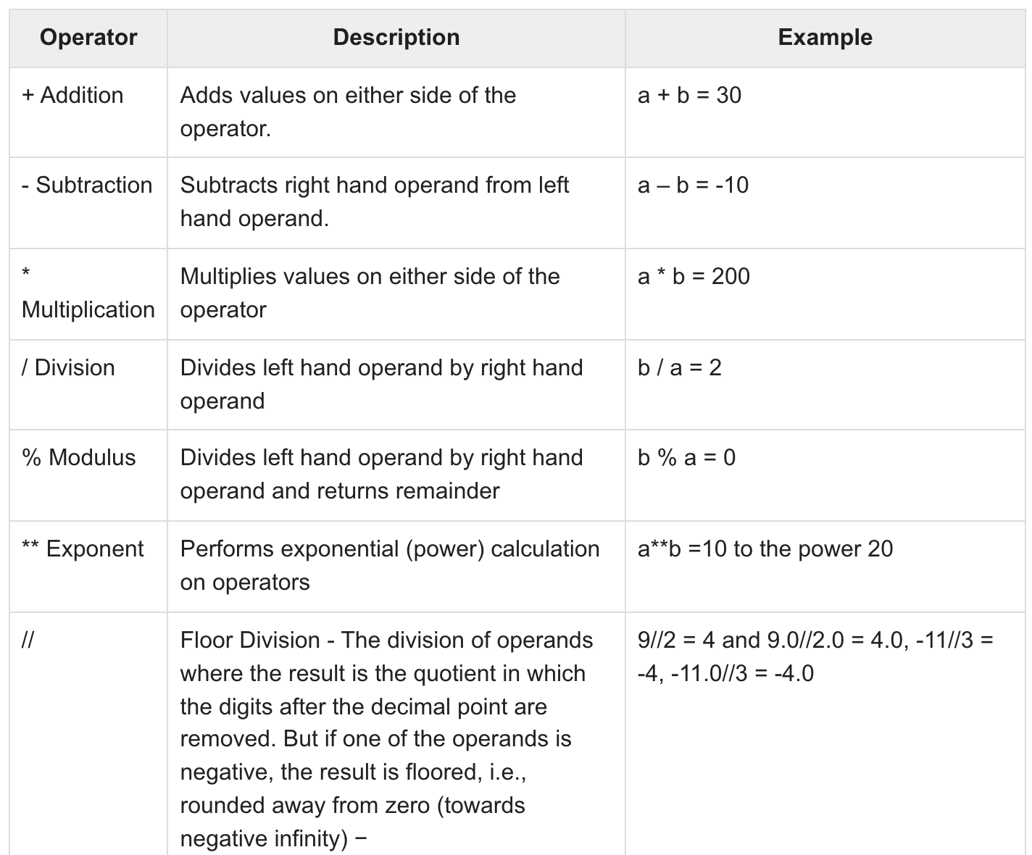
Python Arithmetic Operators
a=10; b=20

Slide 32
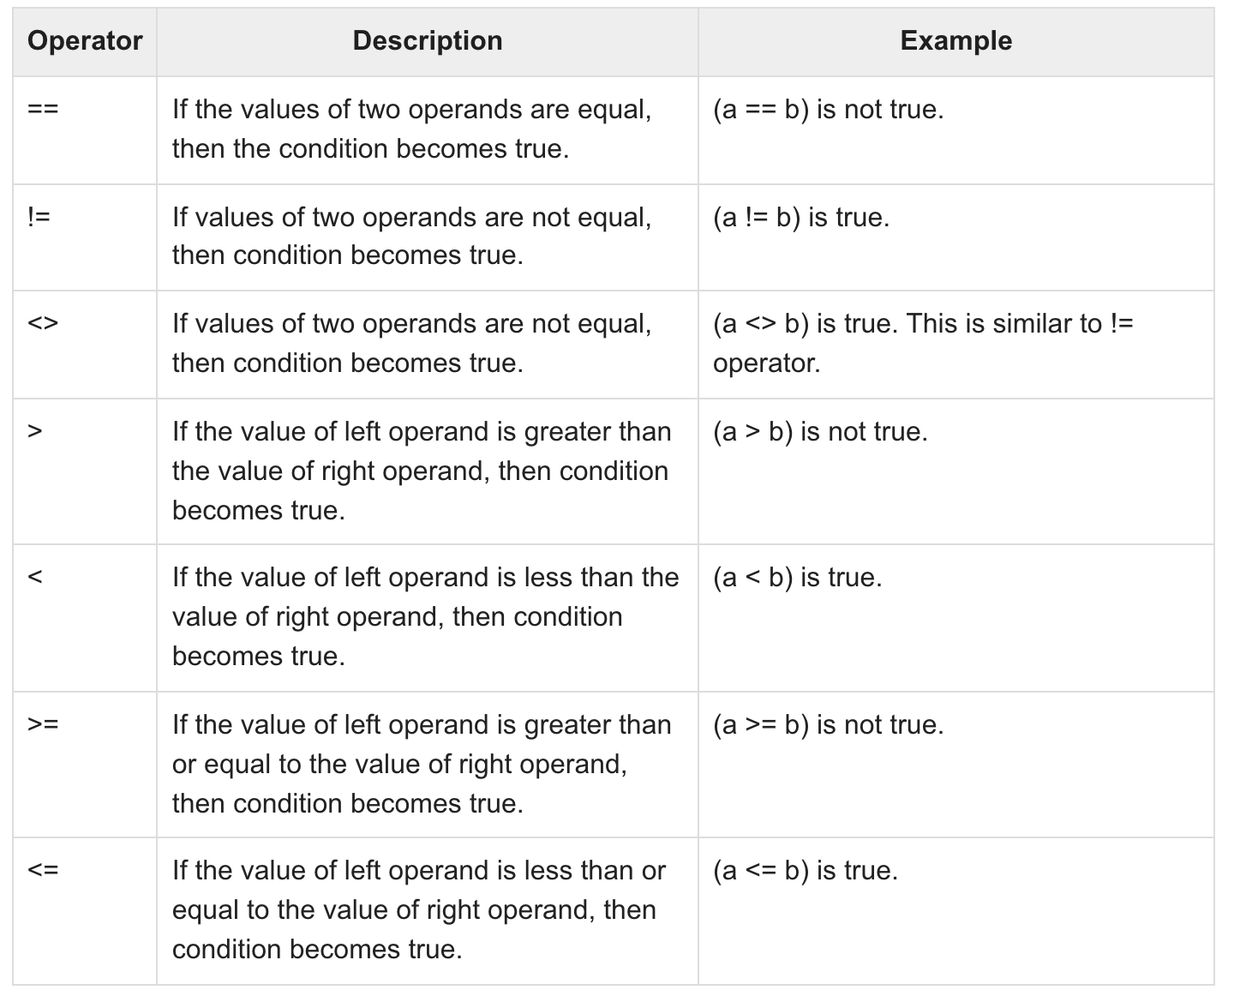
Python Comparison Operators

Slide 33
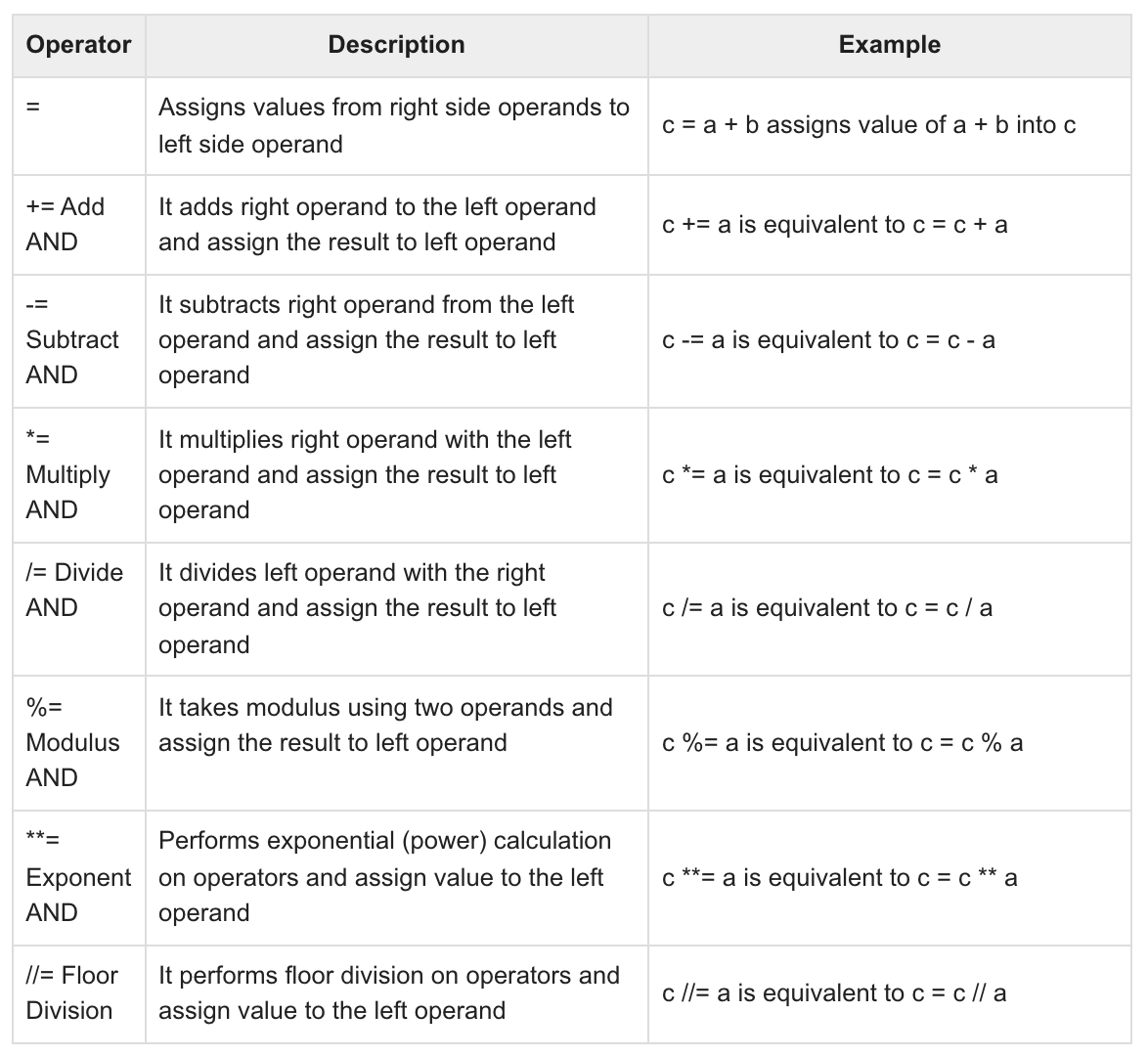
Python Assignment Operators

Slide 34
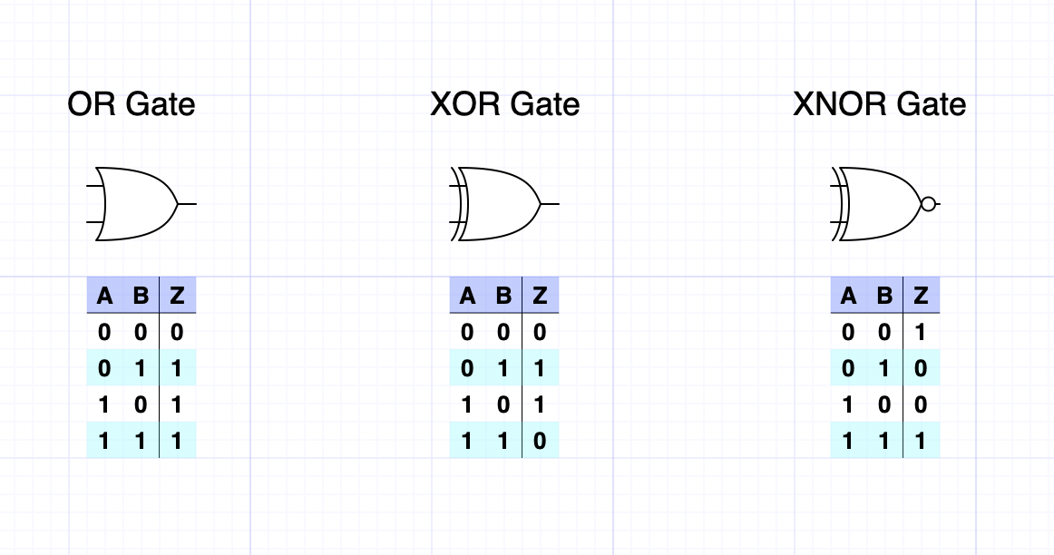
Python Bitwise Operators
Bitwise operator works on bits and performs bit by bit operation. Assume if a = 60; and b = 13; Now in the binary format their values will be 0011 1100 and 0000 1101 respectively. Following table lists out the bitwise operators supported by Python language with an example each in those, we use the above two variables (a and b) as operands −
a = 0011 1100
b = 0000 1101
-----------------
a&b = 0000 1100
a|b = 0011 1101
a^b = 0011 0001
~a = 1100 0011
1162 × 612

Slide 35
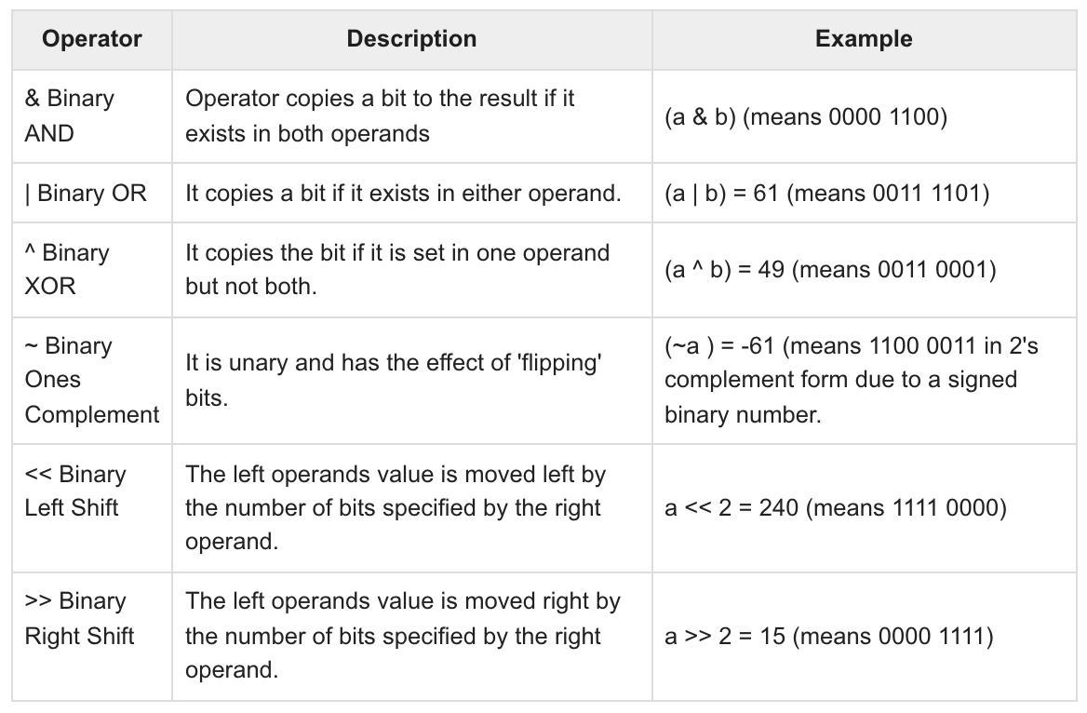

Slide 36
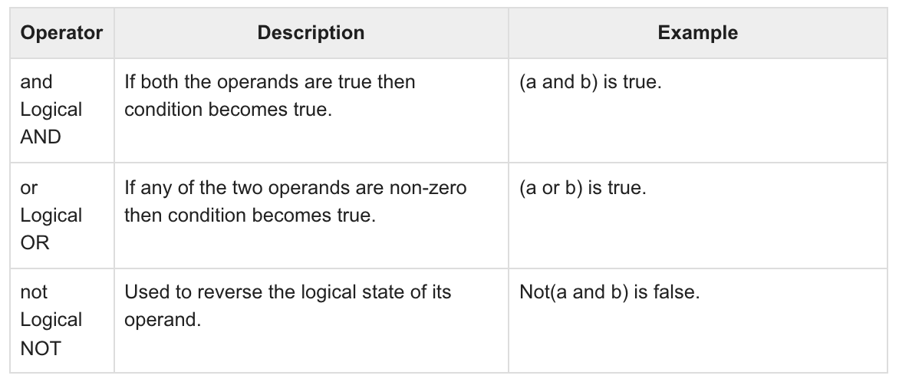
Python Logical Operators

Slide 37
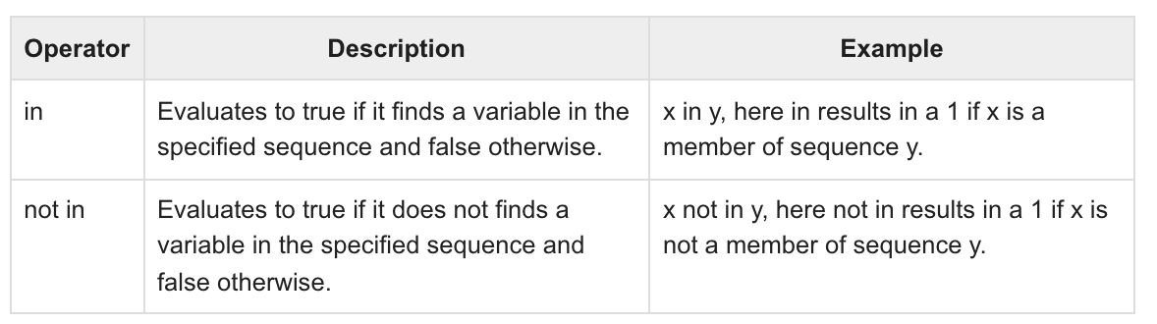
Python Membership Operators
Python’s membership operators test for membership in a sequence, such as strings, lists, or tuples. There are two membership operators as explained below −

Slide 38
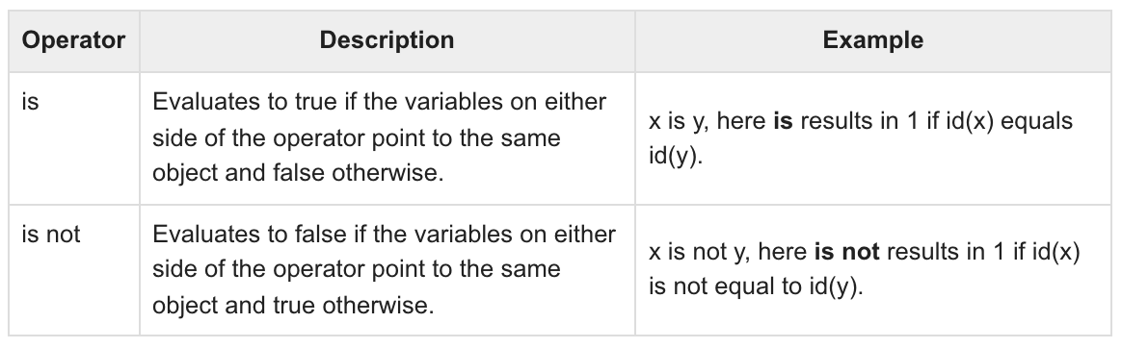
Python Identity Operators
Identity operators compare the memory locations of two objects. There are two Identity operators explained below −

Slide 39
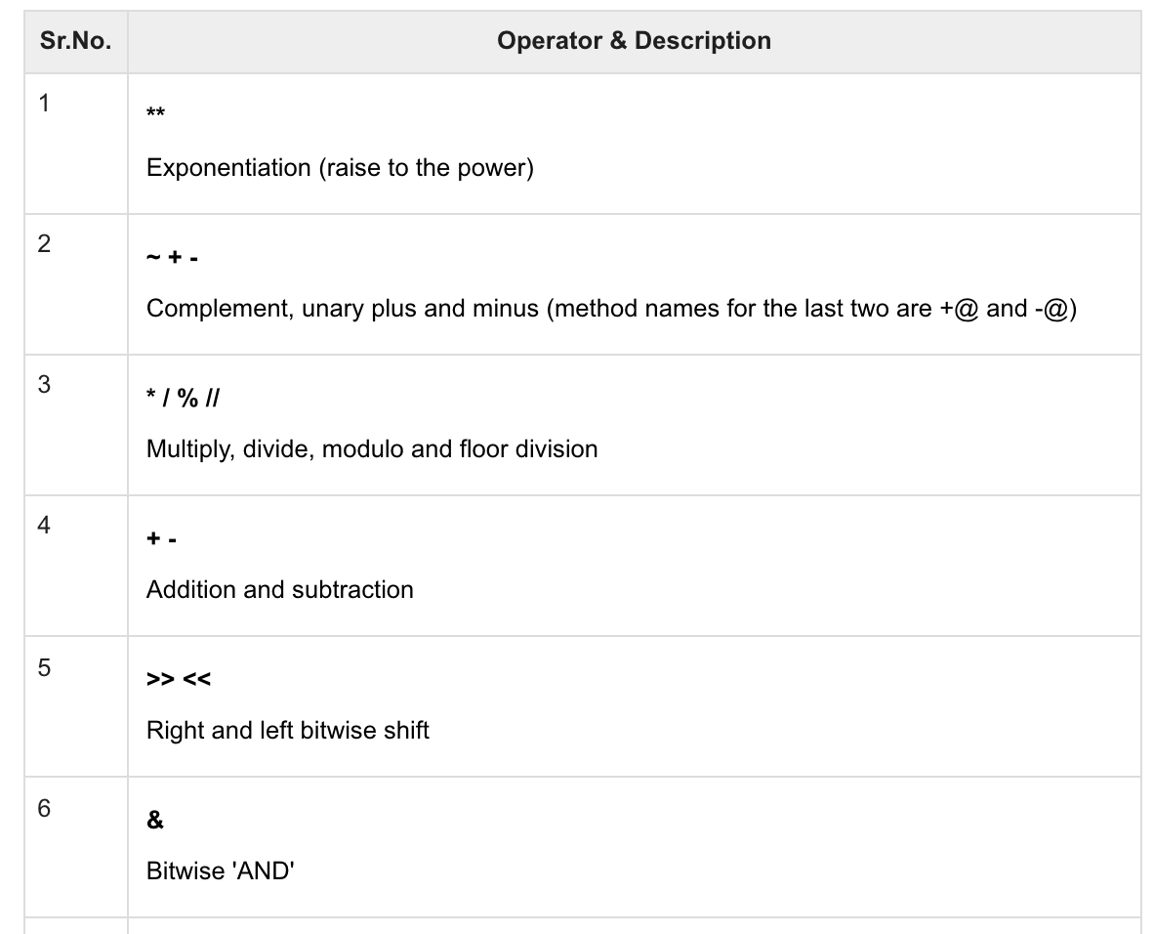
Python Operators Precedence

Slide 40
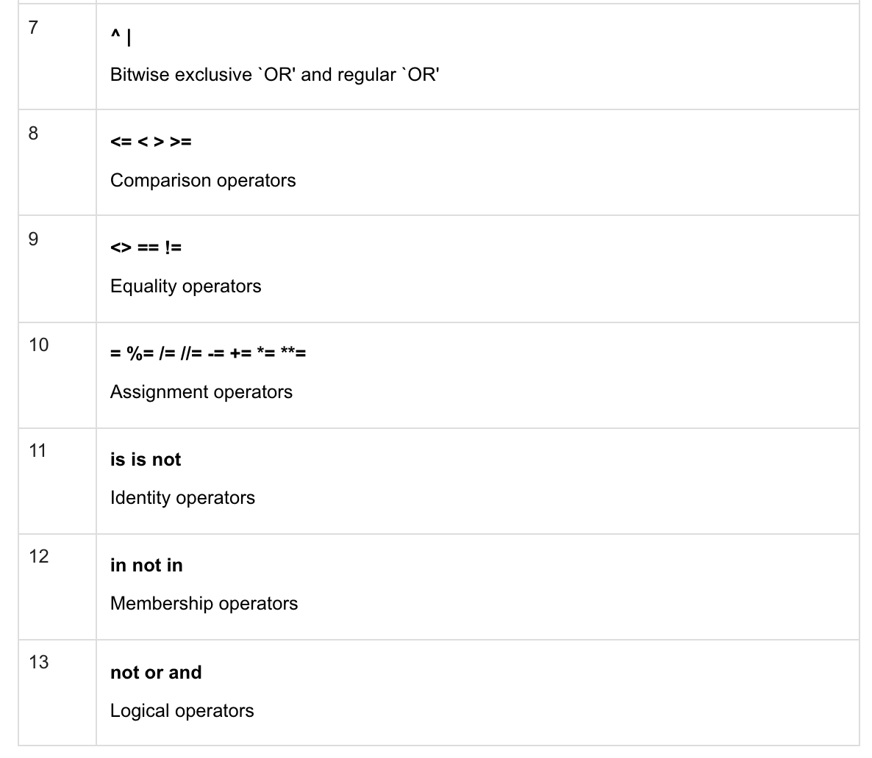

Slide 41
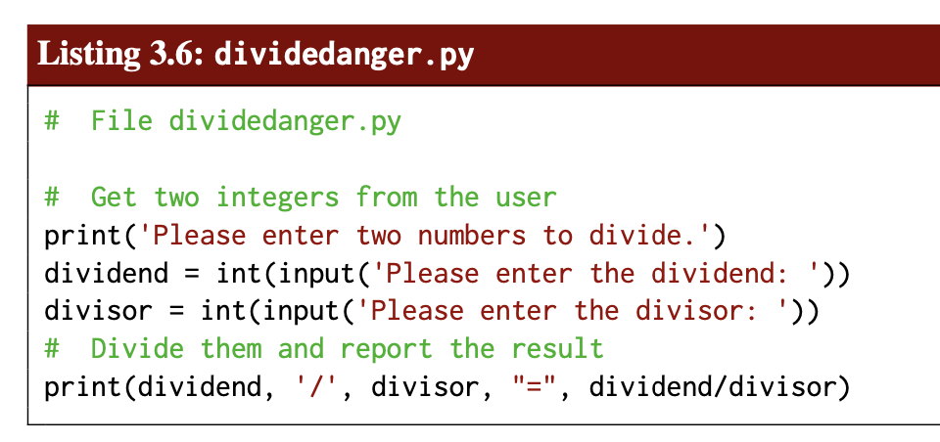

Slide 42
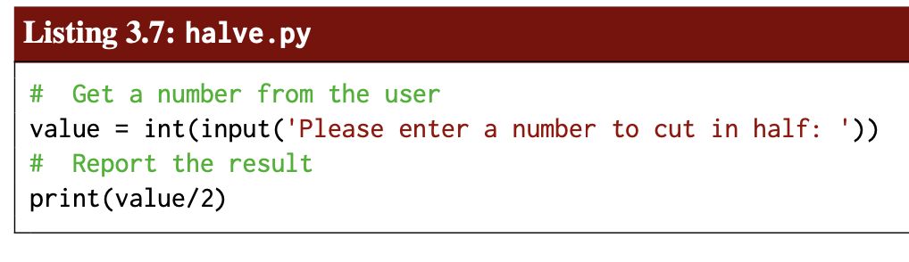

Slide 43
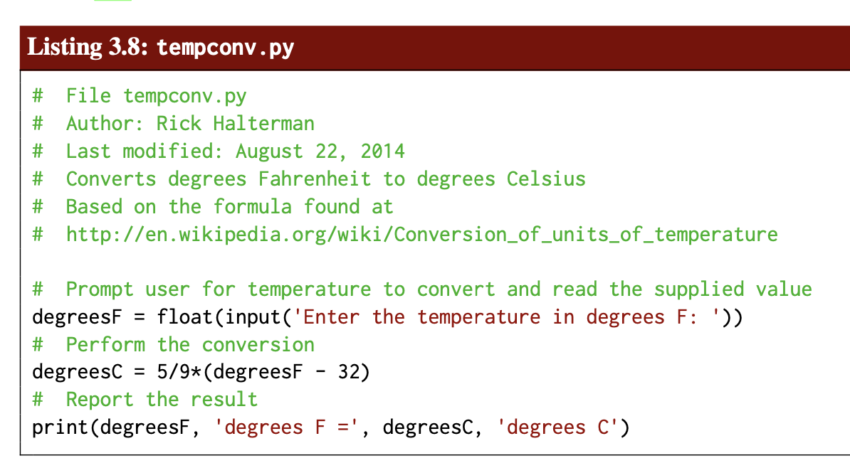

Slide 44
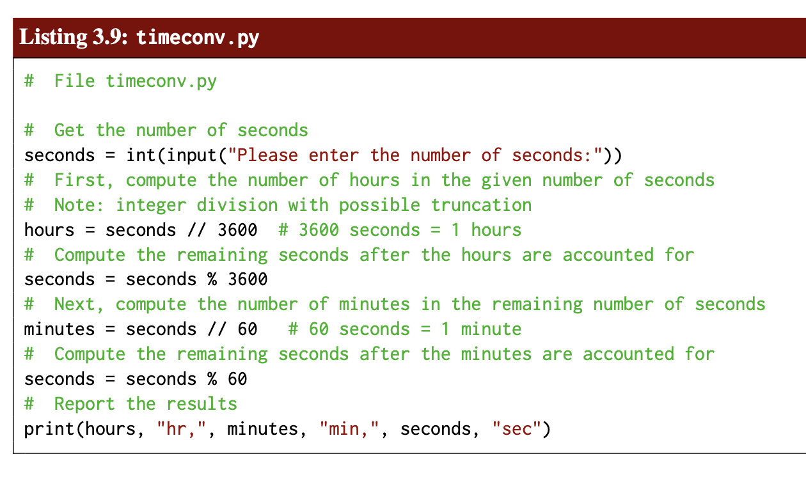

Slide 45
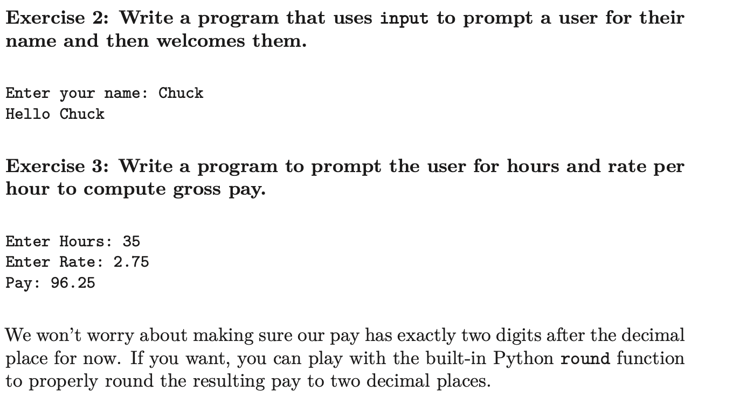

Slide 46
Chapter (4)
Decision Making

Slide 47
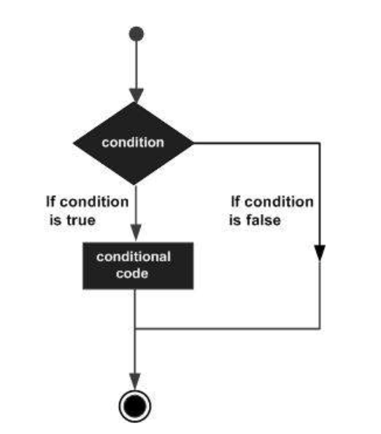
Python - Decision Making
Decision making is anticipation of conditions occurring while execution of the program and specifying actions taken according to the conditions.
Decision structures evaluate multiple expressions which produce TRUE or FALSE as outcome. You need to determine which action to take and which statements to execute if outcome is TRUE or FALSE otherwise.

Slide 48
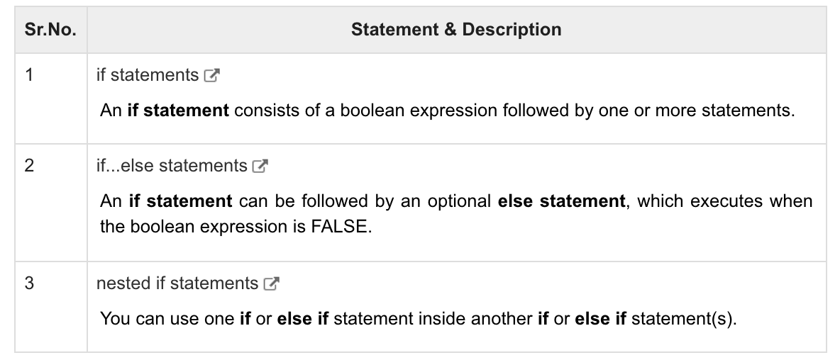

Slide 49
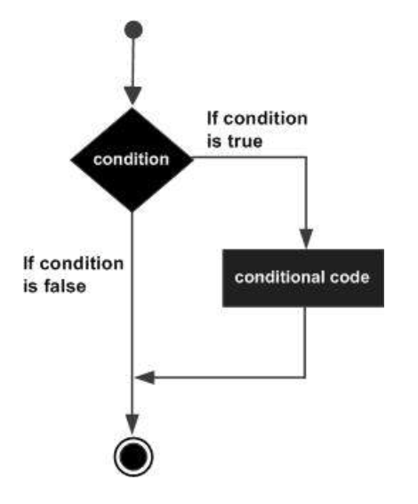
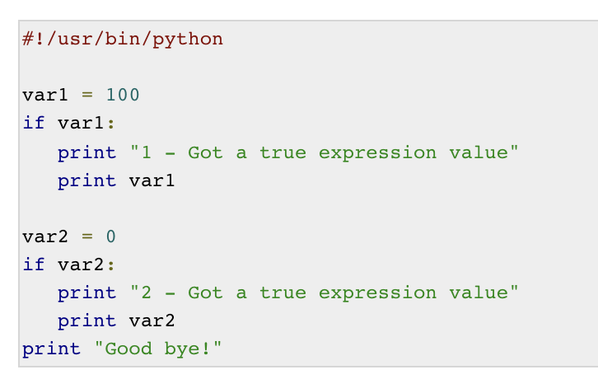
Python IF Statement
if expression:
statement(s)

Slide 50
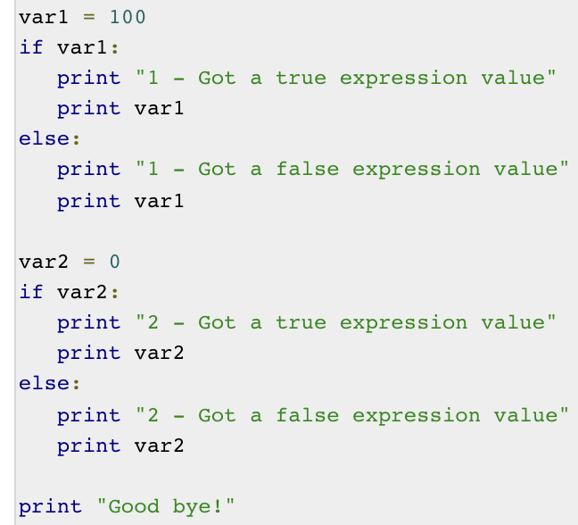
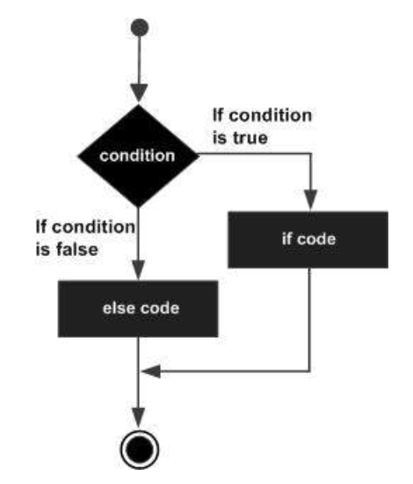
Python IF...ELIF...ELSE Statements
if expression:
statement(s)
else:
statement(s)

Slide 51
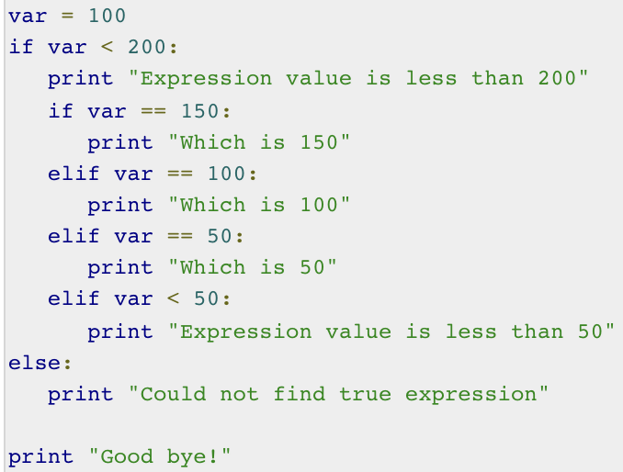
Python nested IF statements
if expression1:
statement(s)
if expression2:
statement(s)
elif expression3:
statement(s)
elif expression4:
statement(s)
else:
statement(s)
else:
statement(s)

Slide 52
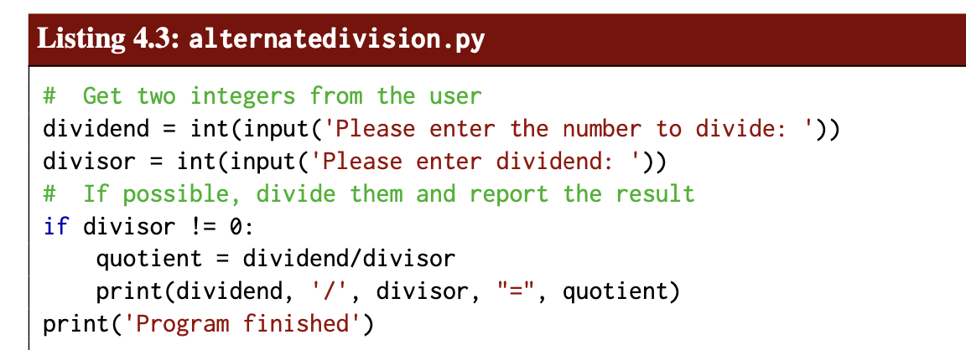

Slide 53
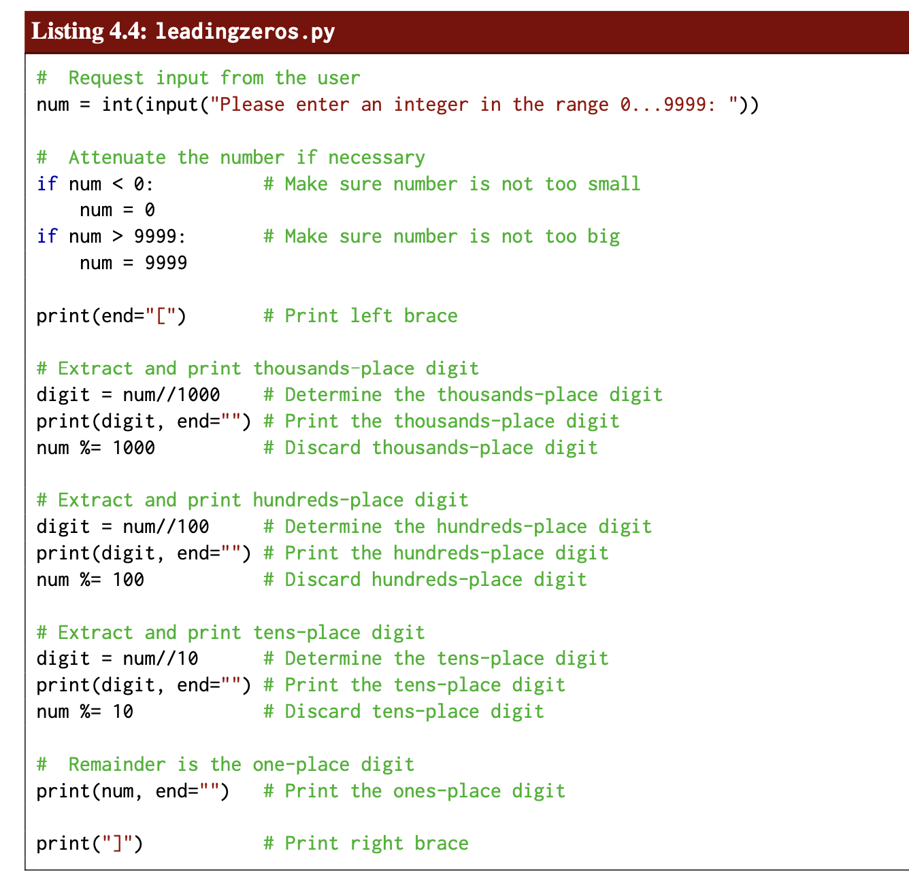

Slide 54
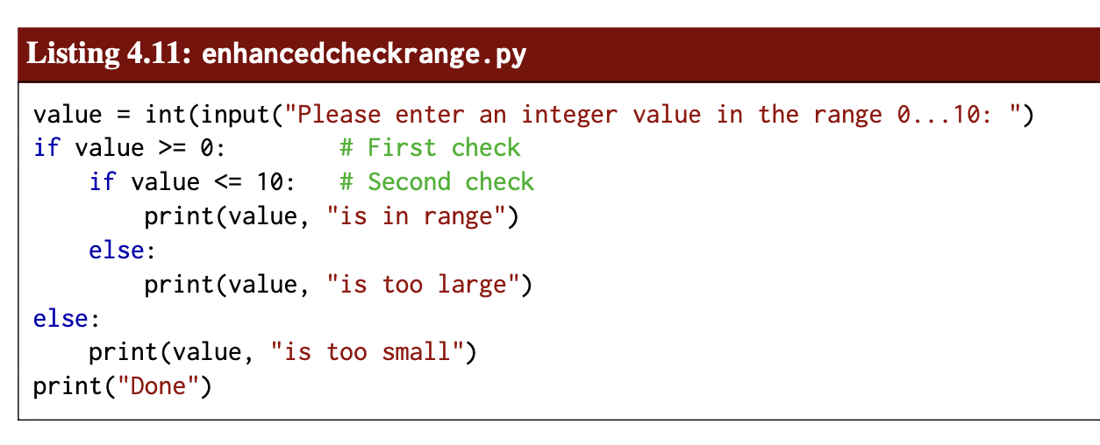

Slide 55
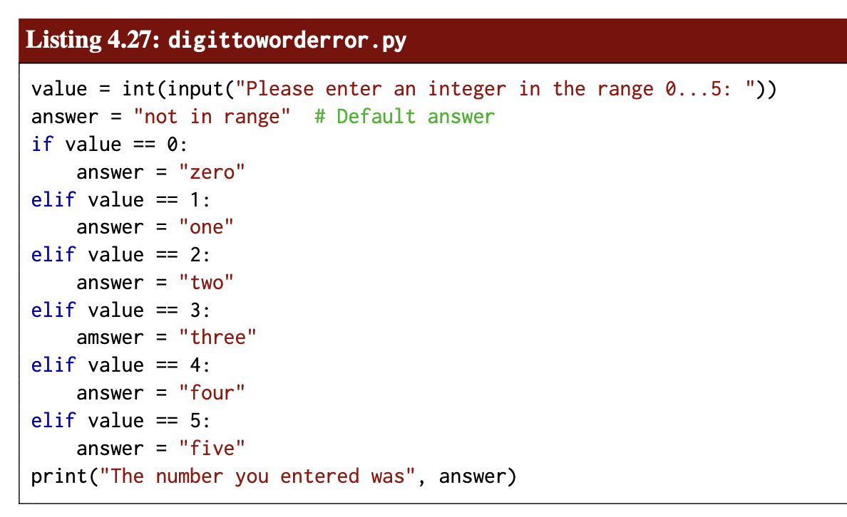

Slide 56
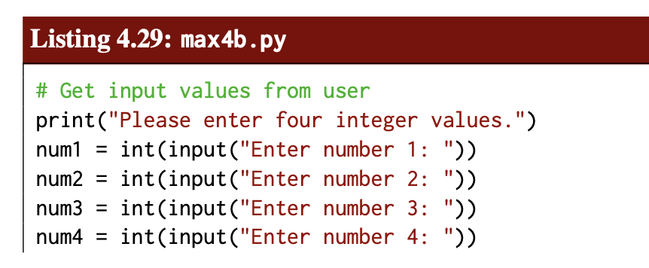
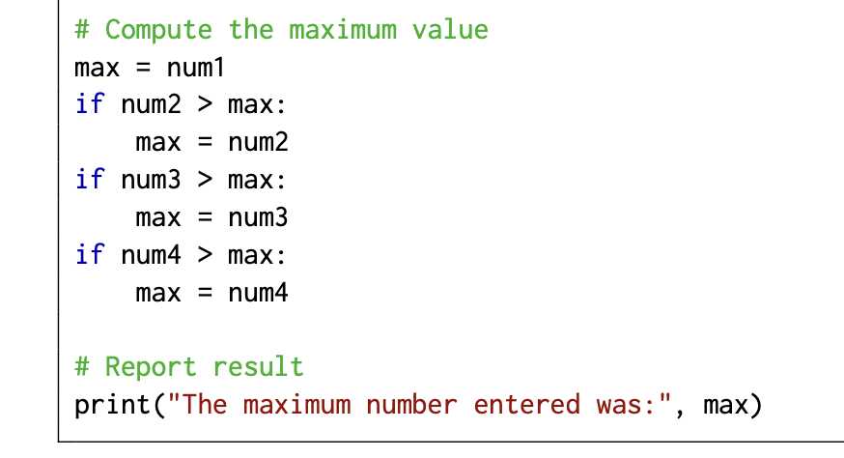

Slide 57
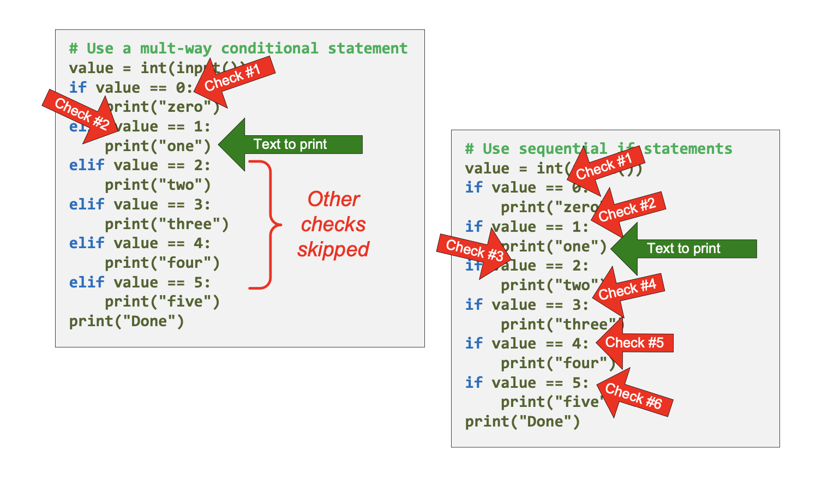

Slide 58
Chapter (5)
Loops

Slide 59
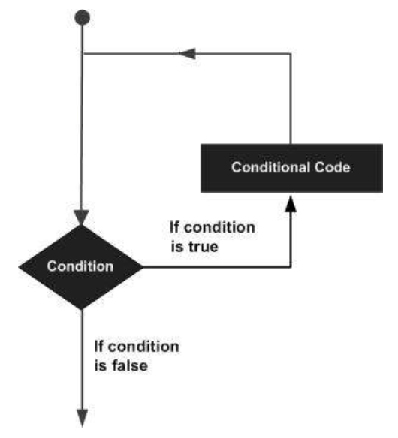
Python - Loops
In general, statements are executed sequentially: The first statement in a function is executed first, followed by the second, and so on. There may be a situation when you need to execute a block of code several number of times.
Programming languages provide various control structures that allow for more complicated execution paths.
A loop statement allows us to execute a statement or group of statements multiple times.

Slide 60
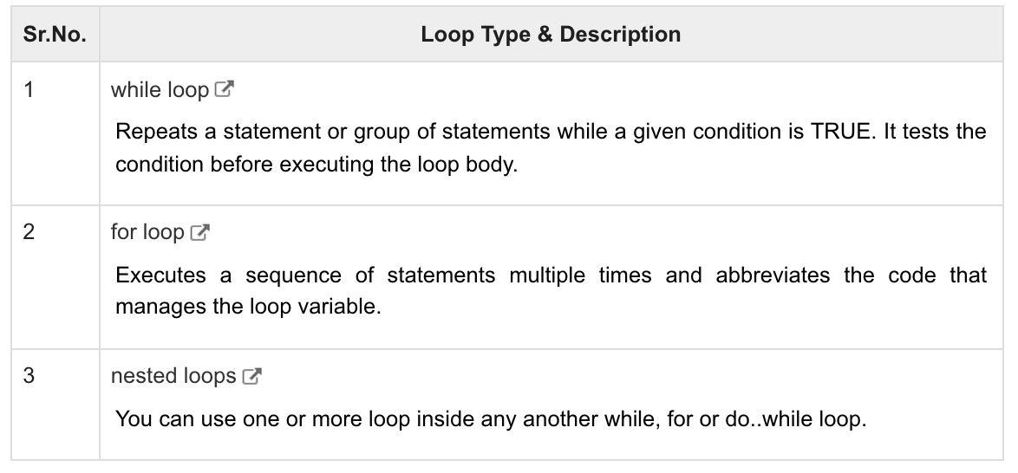

Slide 61
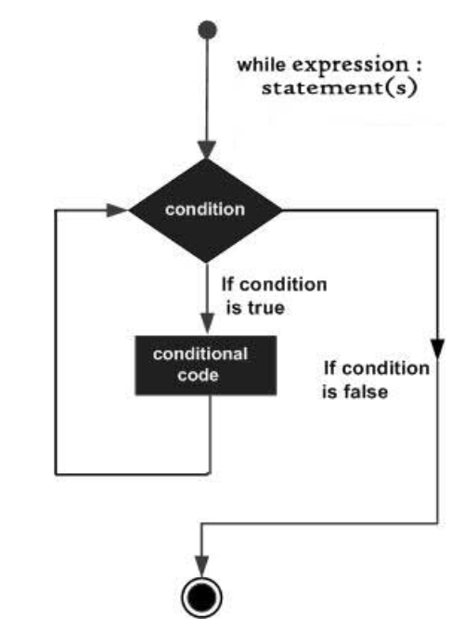
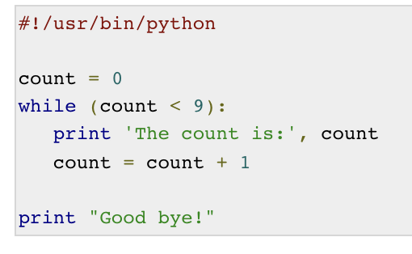
Python while Loop Statements
A while loop statement in Python programming language repeatedly executes a target statement as long as a given condition is true.
while expression:
statement(s)

Slide 62
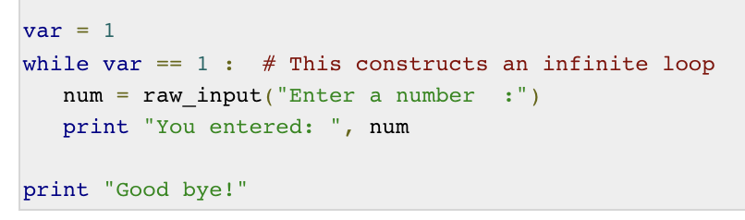
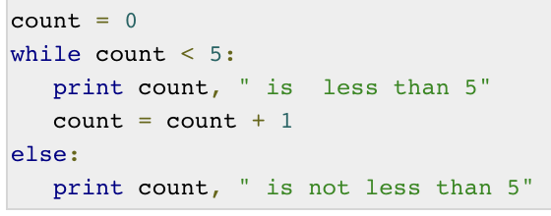
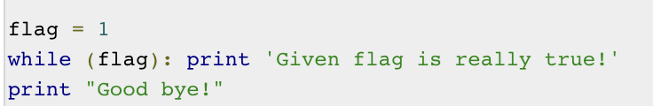

Slide 63
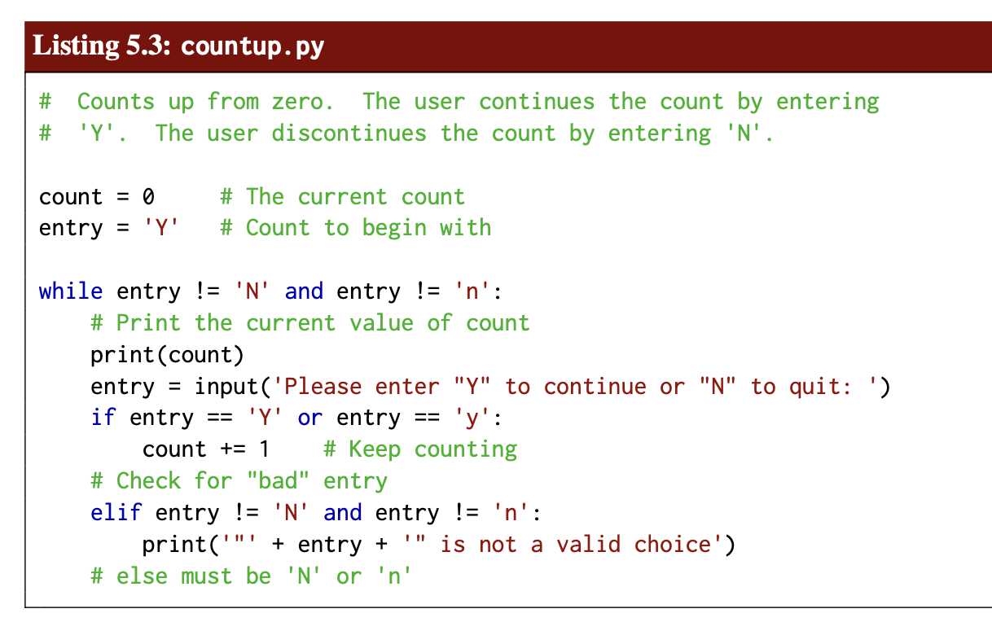

Slide 64
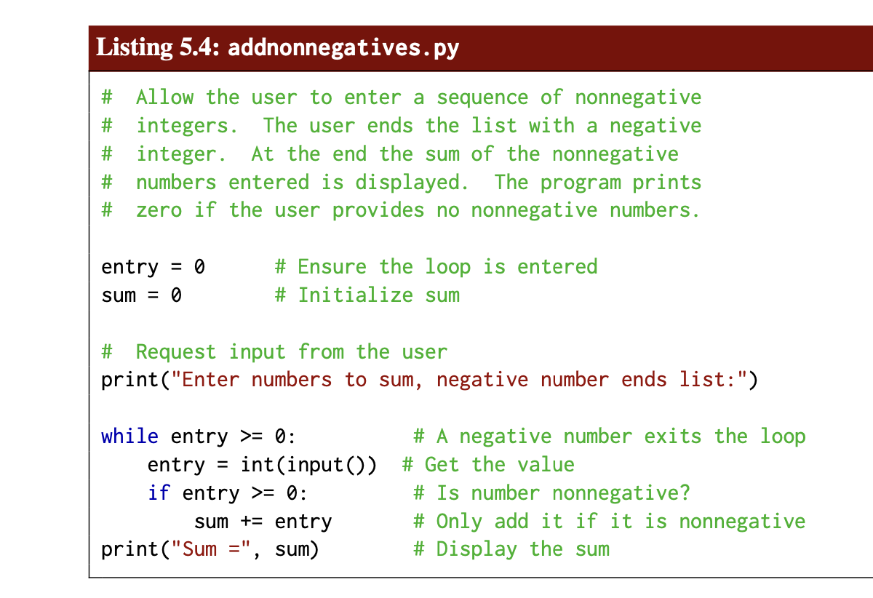

Slide 65
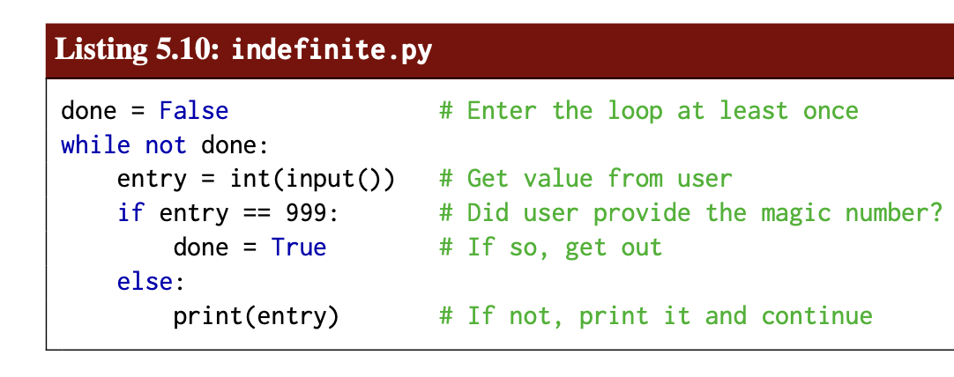

Slide 66
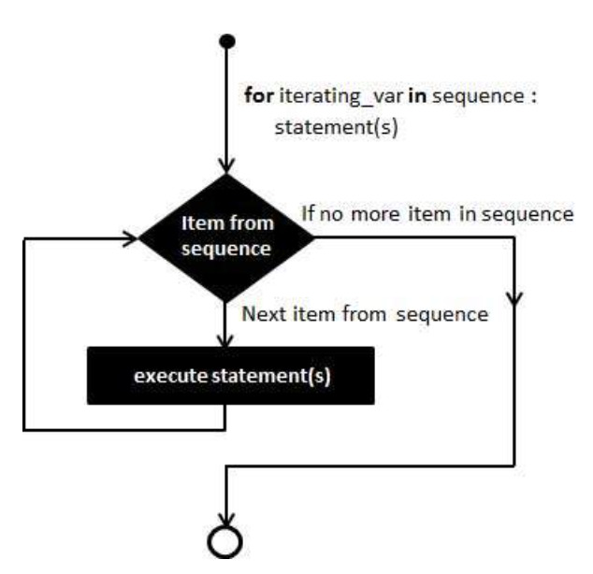
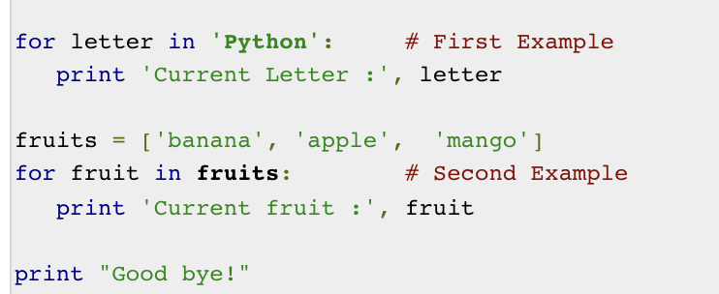
Python for Loop Statements
for iterating_var in sequence:
statements(s)

Slide 67
Iterating by Sequence Index
An alternative way of iterating through each item is by index offset into the sequence itself. Following is a simple example −
fruits = ['banana', 'apple', 'mango']
for index in range(len(fruits)):
print('Current fruit :', fruits[index])
print("Good bye!")

Slide 68

Using else Statement with For Loop
Python supports to have an else statement associated with a loop statement
If the else statement is used with a for loop, the else statement is executed when the loop has exhausted iterating the list.

Slide 69
python nested loops
Python programming language allows to use one loop inside another loop.
for iterating_var in sequence:
for iterating_var in sequence:
statements(s)
statements(s)
The syntax for a nested while loop statement in Python programming language is as follows −
while expression:
while expression:
statement(s)
statement(s)

Slide 70



Slide 71


Slide 72


Slide 73


Slide 74

Loop Control Statements

Slide 75
Python break statement
It terminates the current loop and resumes execution at the next statement, just like the traditional break statement in C.
The most common use for break is when some external condition is triggered requiring a hasty exit from a loop. The break statement can be used in both while and for loops.
If you are using nested loops, the break statement stops the execution of the innermost loop and start executing the next line of code after the block.

Slide 76




Slide 77


Slide 78


Slide 79
Python continue statement
It returns the control to the beginning of the while loop.. The continue statement rejects all the remaining statements in the current iteration of the loop and moves the control back to the top of the loop.
The continue statement can be used in both while and for loops.

Slide 80




Slide 81


Slide 82


Slide 83


Slide 84


Slide 85


Slide 86


Slide 87
Python pass Statement
It is used when a statement is required syntactically but you do not want any command or code to execute.
The pass statement is a null operation; nothing happens when it executes. The pass is also useful in places where your code will eventually go, but has not been written yet

Slide 88



Slide 89

Catching exceptions using try and except
There is a conditional execution structure built into Python to handle these types of expected and unexpected errors called “try / except”. The idea of try and except is that you know that some sequence of instruction(s) may have a problem and you want to add some statements to be executed if an error occurs. These extra statements (the except block) are ignored if there is no error.

Slide 90

Debugging
The traceback Python displays when an error occurs contains a lot of information, but it can be overwhelming. The most useful parts are usually:
• What kind of error it was, and
• Where it occurred.

Slide 91
Chapter (6)
Functions

Slide 92
functions
In Python, a function is a named block of code that performs a specific task. If an executing program needs to perform such a task, it calls upon the function to do the work.

Slide 93



Slide 94

Functions and Module
A Python module is simply a file that contains Python code. The name of the file dictates the name of the module; for example, a file named math.py contains the functions available from the standard math module.

Slide 95


Slide 96

The sys.exit function accepts a single integer argument, which it passed back to the operating system when the program completes. The value zero indicates that the program completed successfully; a nonzero value represents the program terminating due to an error of some kind.

Slide 97

We have used many Python functions
Mathematical functions:
from math import *
y=sin(x)*cos(x)
Other functions:
n=len(somelist)
Integers = range(5,n,2)
Functions used with the dot syntax (called methods):

Slide 98
Functions are one of the most import tools in programming
Function is a collection of statements we can execute wherever and whenever we want
Function can take input objects (arguments) and produce output objects (returned results)
Functions help to organize programs, make them more understandable, shorter, reusable, and easier to extend

Slide 99


Python function for implementing a mathematical function
The mathematical function
can be implemented in Python as follows:
Note:
Functions start with def, then the name of the function, then a list of arguments (here C) - the function header Inside the function:
statements - the function body
Wherever we want, inside the function, we can "stop the function" and return as many values/variables we want

Slide 100

Functions must be called
Note:
The call F(C) produces (returns) a float object, which means that
F(C) is replaced by this float object. We can therefore make the
call F(C) everywhere a float can be used.

Slide 101

Functions can have as many arguments as you like
Make a Python function of the mathematical function

Slide 102


Function arguments become local variables

Slide 103

Functions may access global variables
The yfunc(t,v0) function took two arguments. Could implement y(t) as a function of t only:
Note: v0 and t (in the main program) are global variables, while the t in yfunc is a local variable.

Slide 104

Local variables hide global variables of the same name

Slide 105

Global variables can be changed if declared global

Slide 106



Functions can return multiple values
Multiple return values are separated by comma

Slide 107

Keyword arguments are useful to simplify function

Slide 108

Python convention: input is function arguments, output is returned
A function can have three types of input and output data:
input data specified through positional/keyword arguments
input/output data given as positional/keyword arguments that will be modified and returned output data created inside the function
All output data are returned, all input data are arguments

Slide 109

The main program is the set of statements outside functions
The execution starts with the first statement in the main program and proceeds line by line, top to bottom.
def statements define a function, but the statements inside the function are not executed before the function is called.

Slide 110


Lambda functions for compact inline function definitions

Slide 111

Example on using a lambda function to save typing

Slide 112

We shall write special test functions to verify functions
Rules for test functions:
name begins with test_
no arguments
must have an assert success statement, where success is True if the test passed and False otherwise (assert success, msg prints msg on failure)
The optional msg parameter writes a message if the test fails.

Slide 113

Test functions with many tests
A test function will run silently if all tests pass. If one test above
fails, assert will raise an AssertionError.

Slide 114
Why write test functions according to these rules?
Easy to recognize where functions are verified
Test frameworks, like nose and pytest, can automatically run all your test functions (in a folder tree) and report if any bugs have sneaked in
This is a very well established standard
Unit tests
A test function as test_double() is often referred to as a unit test since it tests a small unit (function) of a program.
When all unit tests work, the whole program is supposed to work.

Slide 115



Slide 116


Slide 117


Slide 118
Chapter (7)
User Inputs and Error Handling

Slide 119
Program inputs
How do professional programs get their input?
Consider a web browser: how do you specify a web address? How do you change the font?
You don't need to go into the program and edit it.
How can we specify input data in programs?
Hardcode values
Ask the user questions and read answers
Read command-line arguments
Read data from a file

Slide 120


Getting input from questions and answers
Sample program:
Idea: let the program ask the user a question "C=?", read the user's answer, assign that answer to the variable C.

Slide 121

Command-line arguments are words written after the program name

Slide 122

How to use a command-line argument in our sample program
The user wants to specify C as a command-line argument after the name of the program when we run the program:
Terminal> python c2f_cml.py 21
69.8
Command-line arguments are the "words" after the program name, and they are stored in the list sys.argv:

Slide 123
Command-line arguments are separated by blanks
Here is another program print_cml.py:
import sys; print sys.argv[1:]
Demonstrations:
Terminal> python print_cml.py 21 string with blanks 1.3
['21', 'string', 'with', 'blanks', '1.3']
Terminal> python print_cml.py 21 "string with blanks" 1.3
['21', 'string with blanks', '1.3']

Slide 124

The magic eval function turns a string into live code
eval(s) evaluates a string object s as if the string had been written directly into the program

Slide 125



Note: be careful with eval and string values
We want r = 'math programming'.Writing just
is the same as writing
which is an invalid expression and illegal syntax.

Slide 126


A similar magic function: exec
eval(s) evaluates an expression s
eval('r = 1+1') is illegal because this is a statement, not only an expression
...but we can use exec to turn one or more complete statements into live code:

Slide 127

exec can be used for building a function at run-time
Embed user's formula in a Python function:

Slide 128

Python built-in functions

Slide 129
Graphical user interfaces
Most programs today fetch input data from graphical user interfaces (GUI), consisting of windows and graphical elements on the screen: buttons, menus, text fields, etc.
Why don't we learn to make such type of programs?
GUI demands much extra complicated programming
Experienced users often prefer command-line input
Programs with command-line or file input can easily be combined with each other, this is difficult with GUI-based programs
Assertion: command-line input will probably fill all your needs in university courses
But let's have a look at GUI programming!

Slide 130


A graphical Celsius-Fahrenheit conversion program
The Celsius degrees can be filled in as a number in a field
Clicking the "is" button computes the
corresponding Fahrenheit temperature

Slide 131
Reading data from files
Scientific data are often available in files. We want to read the data into objects in a program to compute with the data.
Example on a data file.
21.8
18.1
19
23
26
17.8
One number on each line. How can we read these numbers?

Slide 132

How we can write these data to file?

Slide 133


Reading a file line by line
Basic file reading:
Compute the mean values of the numbers in the file:

Slide 134



Alternative ways to read a file
(2) The modern while statement:
Read all lines at once into a list of strings (lines):
(3) Reading the whole file into a string:

Slide 135



Demo of file reading
File:
Line 1. Line 2. Line 3. Line 4.
Session:

Slide 136

More demo of file reading and string splitting

Slide 137
Most data files contain text mixed with numbers
Average rainfall (in mm) in Rome:
1188 months between 1782 and 1970
Jan 81.2
Feb 63.2
Mar 70.3
Apr 55.7
May 53.0
Jun 36.4
Jul 17.5
Aug 27.5
Sep 60.9
Oct 117.7
Nov 111.0
Dec 97.9
Year 792.9

Slide 138

Reading a mixture of text and numbers
The key idea to process each line is to split the line into words:

Slide 139

Can split with respect to any string
s: line.split(s)

Slide 140

Complete program for reading rainfall data

Slide 141

Writing data to file
Basic pattern:

Slide 142

Example: Writing a table to file
Problem:
We have a nested list (rows and columns):
data = \
[[ 0.75, 0.29619813, -0.29619813, -0.75 ],
[ 0.29619813, 0.11697778, -0.11697778, -0.29619813],
[-0.29619813, -0.11697778, 0.11697778, 0.29619813],
[-0.75, -0.29619813, 0.29619813, 0.75 ]]
Write these data to file in tabular form

Slide 143

Example: Writing a table to file

Slide 144
What is a file?
A file is a sequence of characters
For simple text files, each character is one byte (=8 bits, a bit is 0 or 1), which gives 28=256 different characters
(Text files in, e.g., Chinese and Japanese need several bytes for each character)
Save the text "ABCD" to file in Gedit/Emacs and OpenOffice/Word and examine the file!
File reading in Python is about either reading all characters (read) or reading line by line (readline, readlines, for line in fileobj)

Slide 145

We should handle errors in input!
How can we take control, explain what was wrong with the input, and stop the program without strange Python error messages?

Slide 146

Exceptions as an alternative to if tests
Rather than test if something is wrong, recover from error, else do what we indended to do, it is common in Python (and many other languages) to try to do what we indend to, and if it fails, we recover from the error
This principle makes use of a try-except block
If something goes wrong in the try block, Python raises an exception and the execution jumps immediately to the except block.

Slide 147


The temperature conversion program with try-except
Try to read C from the command-line, if it fails, tell the user, and abort execution:

Slide 148


Improvement: test for IndexError and ValueError exceptions

Slide 149
The programmer can raise exceptions
Instead of just letting Python raise exceptions, we can raise our own and tailor the message to the problem at hand
We provide two examples on this:
catching an exception, but raising a new one with an improved (tailored) error message
raising an exception because of wrong input data
Baisc syntax: raise ExceptionType(message)

Slide 150

Examples on re-raising exceptions with better messages

Slide 151


Calling the previous function and running the program

Slide 152


Slide 153


Slide 154


Slide 155
Chapter (8)
Dictionaries and Strings

Slide 156
Goals
Learn more about file reading
Store file data in a new object type: dictionary
Interpret content in files via string manipulation
The main focus in the course is on working with files, dictionaries and strings.

Slide 157
Dictionaries
figfiles = {’fig1.pdf’: 81761, ’fig2.png’: 8754}
figfiles[’fig3.png’] = os.path.getsize(filename)
for name in figfiles:
print (’File size of %g is %d:’ % (name, figfiles[name])

Slide 158
A dictionary is a generalization of a list
Features of lists:
store a sequence of elements in a single object ([1,3,-1])
each element is a Python object
the elements are indexed by integers 0, 1, ...
Dictionaries can index objects in a collection via text
(= “lists with text index”)
Dictionary in Python is called hash, HashMap and associative array in other languages

Slide 159
The list index is sometimes unnatural for locating an element of a collection of objects
Suppose we need to store the temperatures in Oslo, London and Paris.
List solution:
temps = [13, 15.4, 17.5]
# temps[0]: Oslo
# temps[1]: London
# temps[2]: Paris
print ('The temperature in Oslo is', temps[0])
Can look up a temperature by mapping city to index to float
But it would be more natural to write temps[Oslo]!

Slide 160

Dictionaries map strings to objects
Important:
The string index, like Oslo, is called key, while temps['Oslo'] is the associated value
A dictionary is an unordered collection of key-value pairs

Slide 161


Initializing dictionaries
Two ways of initializing a collection of key-value pairs:
Adding elements to dictionary

Slide 162


Looping (iterating) over a dict means looping over the keys
for key in dictionary:
value = dictionary[key]
print value
Note: the sequence of keys is arbitrary! Use sort if you need a particular sequence:

Slide 163


Can test for particular keys, delete elements, etc
Delete an element of a dict:
Does the dict have a particular key?

Slide 164

The keys and values can be reached as lists

Slide 165



Caution: two variables can alter the same dictionary

Slide 166

Any constant object can be used as key

Slide 167

Example: Polynomials represented by dictionaries
The information in the polynomial
p(x)=-1+x² +3x⁷
can be represented by a dict with power as key (int) and coefficient as value (float):
p = {0: -1, 2: 1, 7: 3.5}

Slide 168



Example: Read File data into a dictionary

Slide 169

A tabular file can be read into a nested dictionary

Slide 170
We must first develop the plan (algorithm) for doing this
1) Examine the first line:
1 split it into words
2 initialize a dictionary with the property names as keys and empty dictionaries {} as values
2) For each of the remaining lines:
1 split line into words
2 for each word after the first: if word is not no, convert to float and store

Slide 171


Complete Python Code

Slide 172

String Manipulation (Part2)
String manipulation is key to interpret the content of files
Text in Python is represented as strings
Inspecting and manipulating strings is the way we can understand the contents of files
Plan: first show basic operations, then address real examples

Slide 173


String Manipulation (Part2)
Strings behave much like lists/tuples - they are a sequence of characters:
Sample string used for illustrations:
Substrings are just as slices of lists and arrays:

Slide 174


Substituting a substring by another string

Slide 175


Splitting a string into a list of substrings

Slide 176

Splitting a string into lines
Very often, a string contains lots of text and we want to split the text into separate lines
Lines may be separated by different control characters on different platforms:
\n on Unix/Linux/Mac, \r\n on Windows

Slide 177


Strings are constant - immutable - objects
You cannot change a string in-place (as you can with lists and arrays)
- all changes of a strings results in a new string

Slide 178

Stripping of leading/trailing whitespace

Slide 179


Some convenient string functions

Slide 180


Joining a list of substrings to a new string
These are inverse operations:
t = delimiter.join(stringlist)
stringlist = t.split(delimiter)
We can put strings together with a delimiter in between:
Split of the first two words on a line:

Slide 181

Example: Read pairs of numbers (x,y) from a file

Slide 182


Implementation

Slide 183

Alternative solution: Python syntax in file format

Slide 184

Web pages are nothing but text files

Slide 185

Programs can extract data from web pages

Slide 186
import urllib.request
user_agent = 'Mozilla/5.0 (Windows; U; Windows NT 5.1; en-US; rv:1.9.0.7) Gecko/2009021910 Firefox/3.0.7'
baseurl = 'https://www.metoffice.gov.uk/pub/data/weather/uk/climate/stationdata'
filename= 'oxforddata.txt'
url = baseurl + '/' + filename
headers={'User-Agent':user_agent,}
request=urllib.request.Request(url,None,headers)
#The assembled request
response = urllib.request.urlopen(request)
data = response.read()
# The data u need
file=open('Oxford.dat','w')
file.write(str(data))
file.close()

Slide 187

The structure of the Oxfort.dat weather data file

Slide 188


Reading the climate data

Slide 189

Reading the climate data

Slide 190


Slide 191


Slide 192


